Slide 1
Case Based Complexity
Computational Social Science
Lecture 2

Slide 2
Overview
Big data is not just about amount of data, there is difference in kind
Data mining methods are big data algorithms to analyse cases
Look for patterns of similarity and difference
Algorithms conceptualise cases as points in multidimensional space, so similar cases are close to each other
Data mining methods create clusters of cases that are similar to each other and different from other cases
Introduce k-means clustering, hierarchical clustering, self organised maps
Introduce tools that can interpret clusters

Slide 3
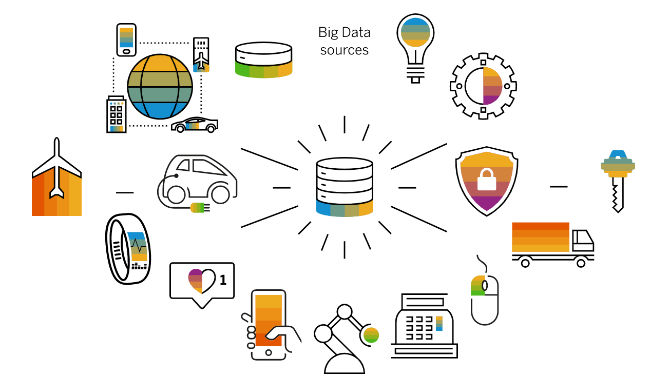
Big Data
SAP Insights, What is Big Data?
https://www.sap.com/uk/insights/what-is-big-data.html

Slide 4
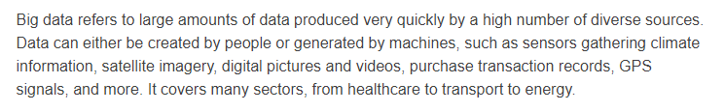
What is Big Data?
Original definitions emphasised 3Vs
Volume
Velocity
Variety
Data with these characteristics could not be managed with existing technology (storage, relational datasets)
European Commission, Shaping Europe’s Digital Future
https://digital-strategy.ec.europa.eu/en/policies/big-data

Slide 5
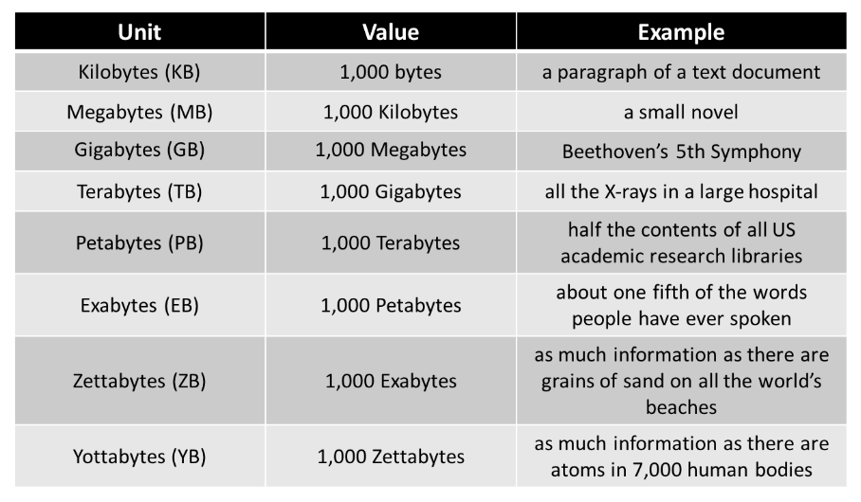
Volume is large
Volume is simply the size of the data
For big data, the data exceeds the storage of individual computers
1.2 ZB internet traffic in 2016 (Cisco)
Barnett, The Zettabyte Era Officially Begins
https://blogs.cisco.com/sp/the-zettabyte-era-officially-begins-how-much-is-that)
NASA, Data volume units
https://mynasadata.larc.nasa.gov/basic-page/data-volume-units
From Roy Williams, Powers of 10

Slide 6
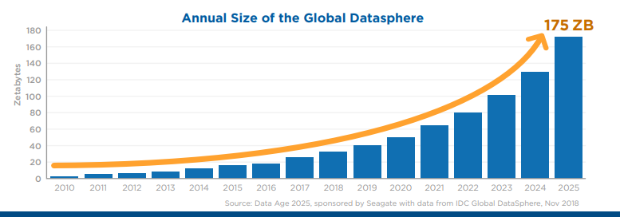
Volume is growing
Reinsel, Gantz, Rydning (2018), Data Age 2025: The Digitization of the World, IDC White Paper – #US44413318
https://www.seagate.com/files/www-content/our-story/trends/files/idc-seagate-dataage-whitepaper.pdf

Slide 7
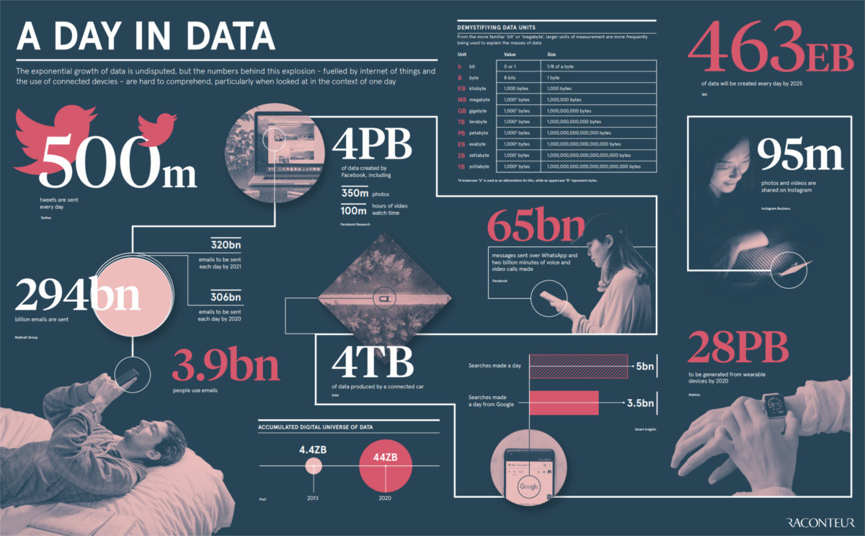
Volume driven by social media, video and digital devices
Desjardins (2019), How much data is generated each day?
https://www.visualcapitalist.com/how-much-data-is-generated-each-day/

Slide 8

Velocity
Data streams generated and arriving at high speed
Real time sensor data
Transactional data such as financial data
Data must be processed at speed
Decisions
Importance of being first for financial decisions
Data protection and security
Self driving cars
On average, must be processed at least as quickly as arrives

Slide 9
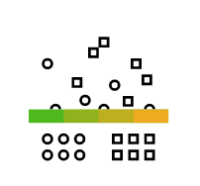
Variety
Different types of data
Structured datasets, easy to store and process
Unstructured data such as text and video
Geospatial
Sensor traces
SAP Insights, What is Big Data?
https://www.sap.com/uk/insights/what-is-big-data.html

Slide 10
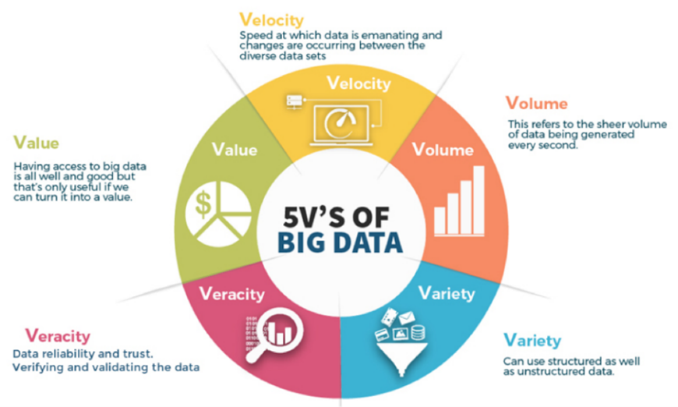
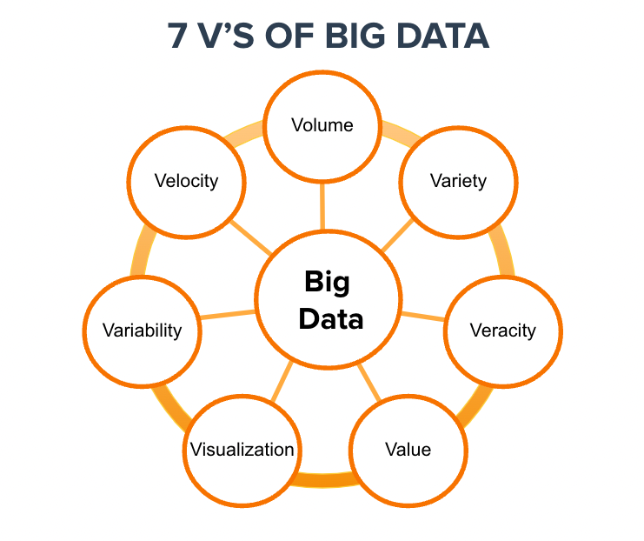
Other challenges of big data More Vs and other letters
Veracity: unstructured data has different accuracy issues
Fake news
Variability: inconsistencies in the flow (volume, velocity) can crash infrastructure
Searches when news item
Value: is it useful?
Vulnerability: how to keep data secure?
Visualisation: how to understand big data?
https://sis.binus.ac.id/2020/09/28/karakateristik-big-data/
https://impact.com/marketing-intelligence/7-vs-big-data/

Slide 11
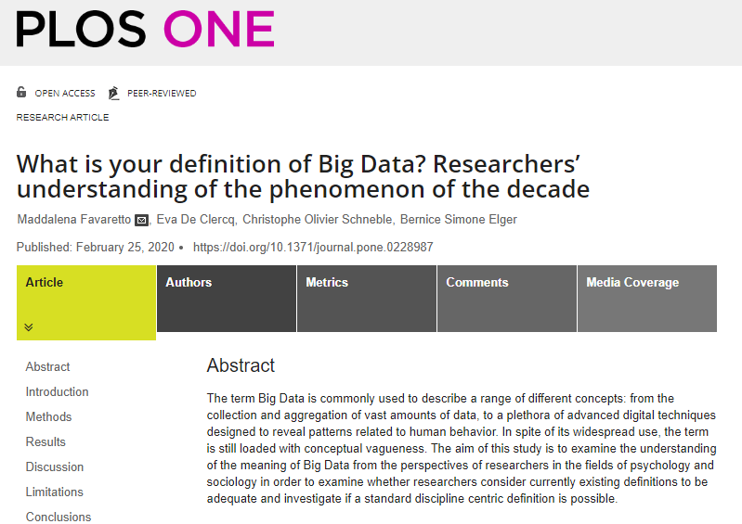
Other aspects
No agreed definition or conceptual clarity
Description of society
Buzzword for funding and marketing
Defined by methods required to analyse and interpret the data
https://doi.org/10.1371/journal.pone.0228987

Slide 12


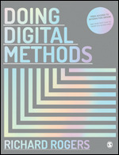
Digital sociology
Broader than new methods to research old questions
Interplay between people, ideas and technology
Samaritan app intended to identify those at suicide risk from tweets -> concern about stigma and self-censoring
New questions about social phenomena
Digital activism contributes to civil resistance but also exposes activists to surveillance
New questions about methods
Social media and by-product data has no real consent
If social scientists are to make sense of digital saturated world
Embrace new and different methods and methodologies
Critically advance digital methods

Slide 13

Machine Learning
https://xkcd.com/1838

Slide 14

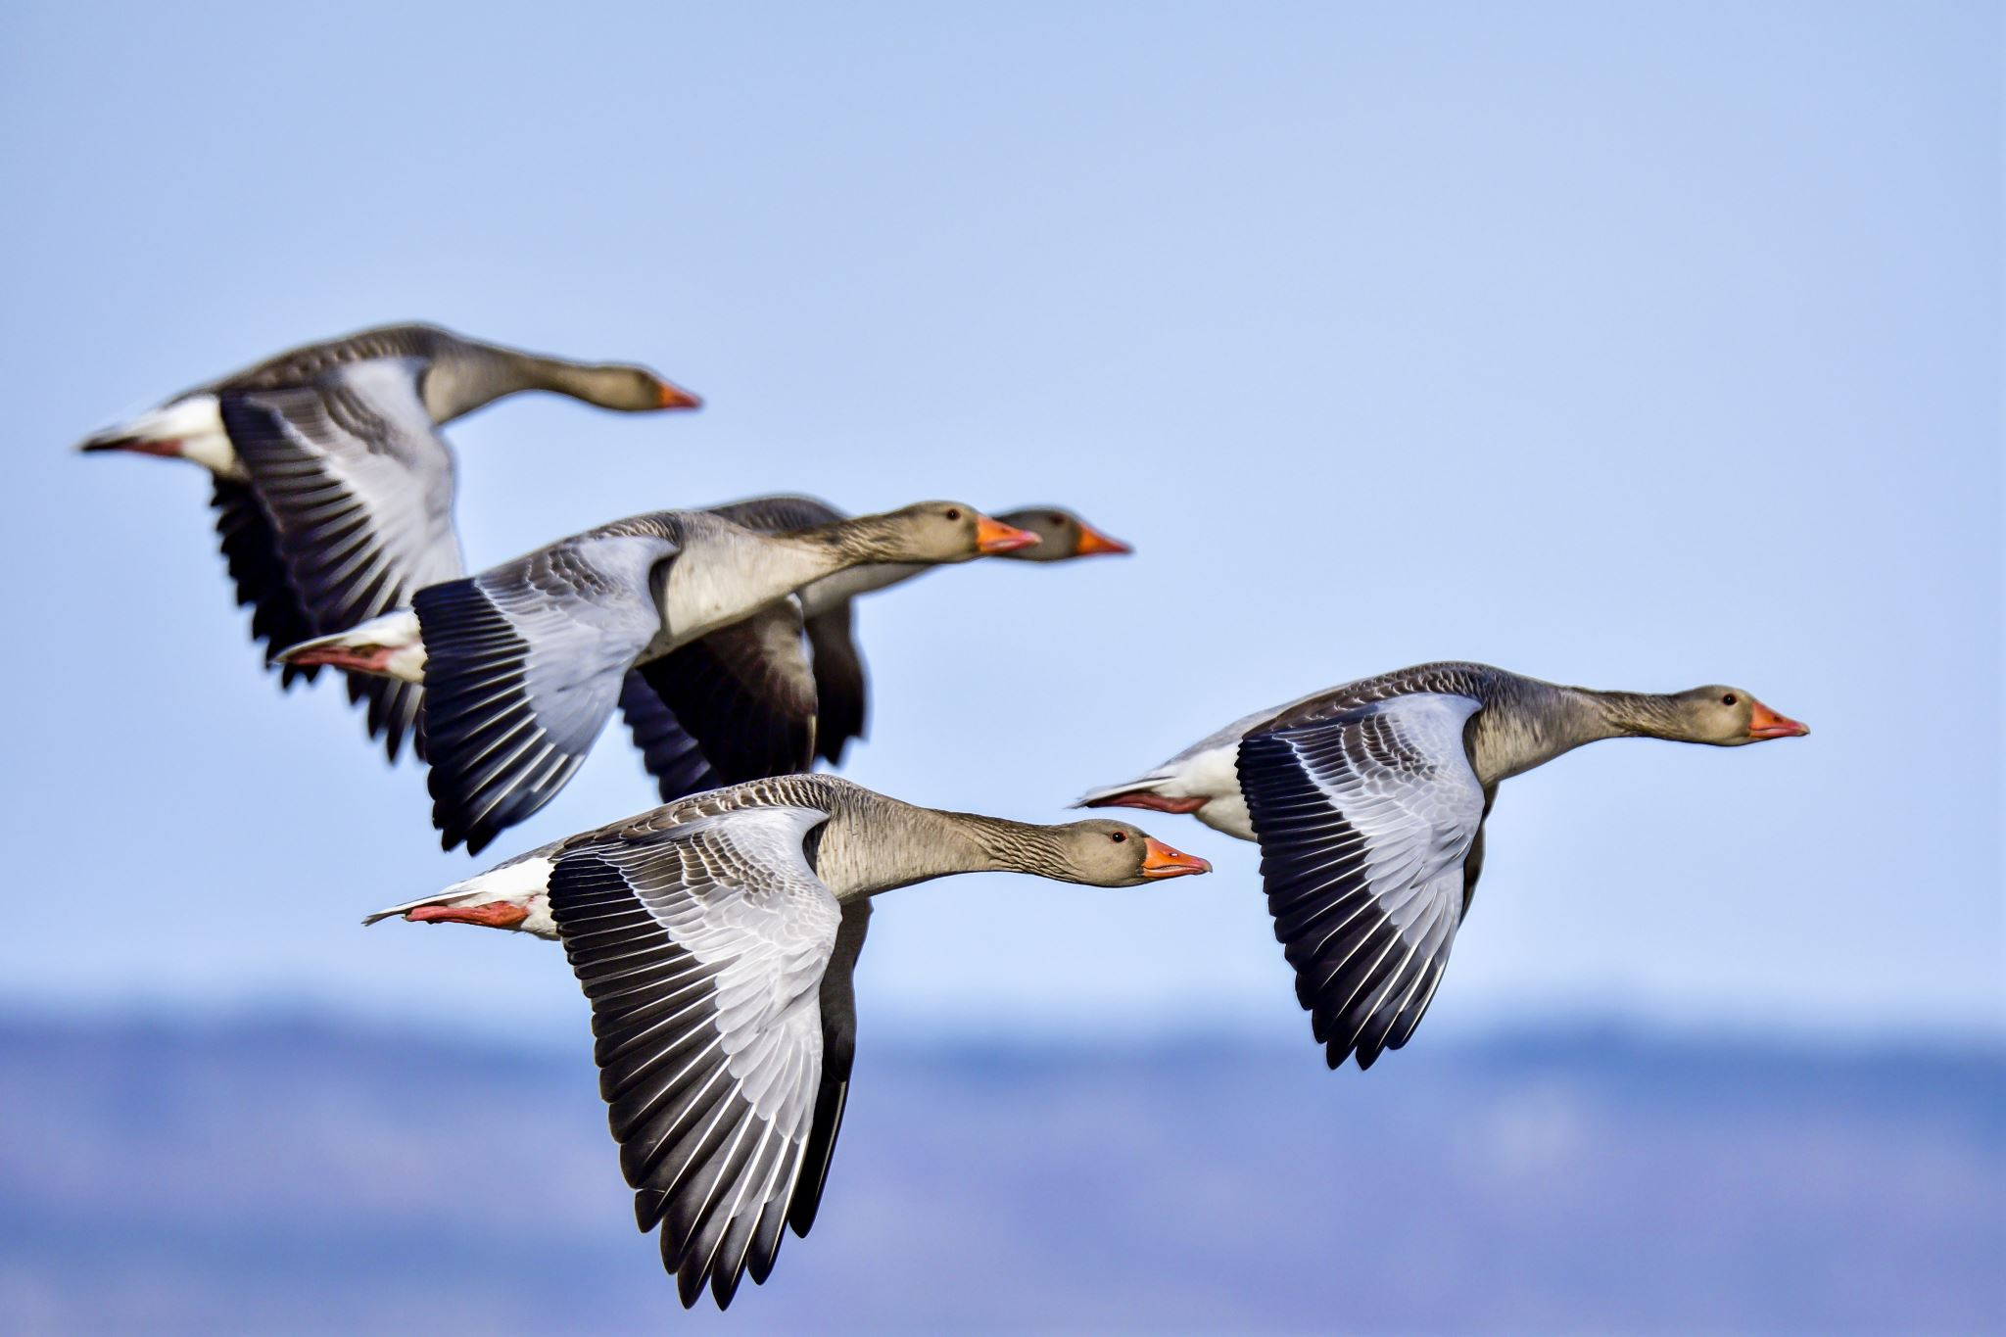
What is artificial intelligence (AI)?
Developing computers (including robots) that can:
Emulate human thought
Deal with real world
Turing test: can a computer fool a human (written) interrogator into thinking it is human?
Outcome is measured, not whether it thinks like a human
Aeroplanes and birds both use wings to fly, but in different ways

Slide 15



What is machine learning (ML)?
Machines don’t ‘learn’: An analyst gives the computer a rule to follow about how to solve a problem
Problems in ML are about finding patterns in data
ML is a path to artificial intelligence
The discipline of ML is about
Developing algorithms to detect new types of patterns
Developing new algorithms to better detect patterns
Making existing algorithms faster or otherwise better
Social science uses those algorithms to understand social phenomena

Slide 16
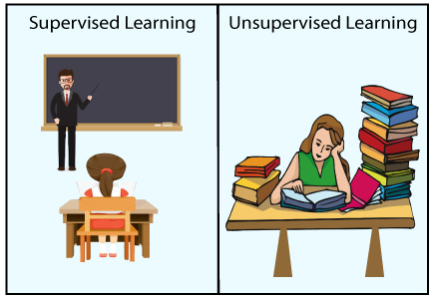
Two broad types of machine learning algorithms
Artist unknown

Slide 17








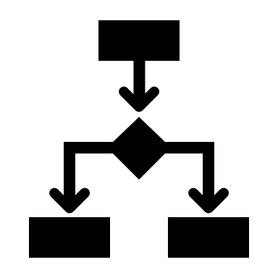


Supervised learning
Apples
Not apples
Training data to the algorithm
Each input is labelled (ground truth)
Is or not an apple
Algorithm develops a rule for how to classify
Rule is used on new input to predict class or value
?

Slide 18
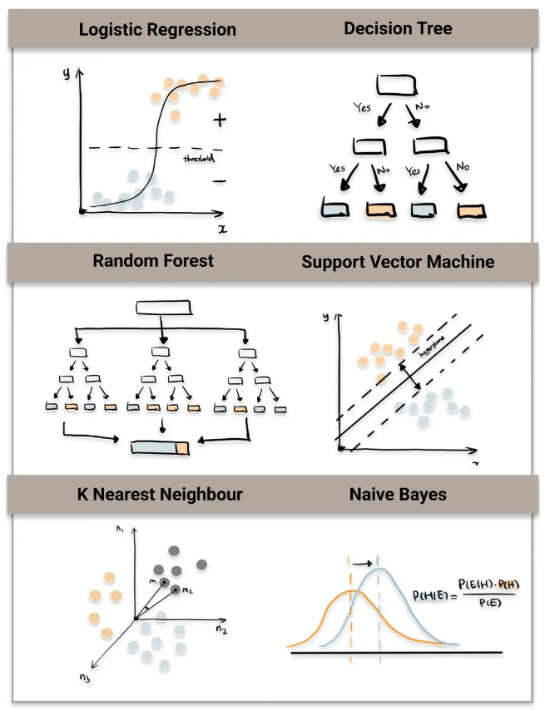
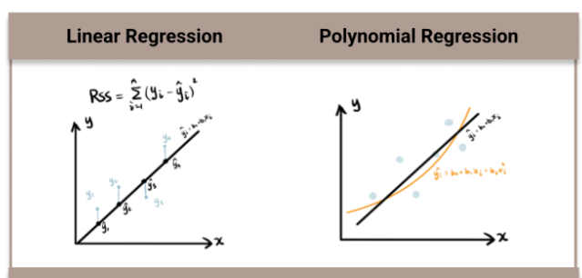
Supervised learning
Two types of output
Classification: predict label
Regression: predict value
Examples
Spam detection
Image recognition
Sentiment analysis
Credit risk
Supervised learning algorithms maximise predictive accuracy
Developed rules
Ignore input similarity
Ignore input meaning
May not be interpretable, human cannot understand how the prediction is made
Not suitable for our purposes
Complexity stripped away
Destin Gong
https://www.visual-design.net/

Slide 19

Unsupervised learning
When applied, two older terms are used
Data Mining
Knowledge Discovery [in Databases, hence KDD]
Unsupervised learning is exploratory
Finds patterns
Many algorithms do not require training
Patterns illuminate how a complex social phenomenon is organised
Case based complexity
Gain insight into the phenomenon

Slide 20
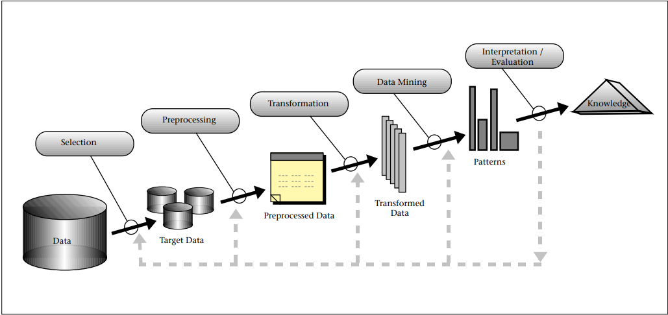
General approach to KDD
(5) Choose method
(6) Method tuning
(7) Apply method
(4) Reduce dimensions, rescale
(8) Interpret, visualise patterns
(3) Clean, missing
(1,2) Select (sub)set of relevant data
(9) Act on knowledge, including resolving conflicts with previous knowledge
Cyclic – discovered patterns may require iteration from any previous step
Fayyad, Piatetsky-Shapiro, Smyth (1996). “From data mining to knowledge discovery in databases” in AI Magazine, 17(3)

Slide 21
KDD is explicitly exploratory and iterative
Interplay between human interpreter and computer algorithms
Data mining is the pattern extraction step made by the computer in KDD process
Human role is twofold
Prepare the data so of sufficient quality
Decide if pattern is knowledge
Pattern is ‘knowledge’ if it is sufficiently interesting
Valid, novel, simple, useful
Blind application of data-mining methods can be a dangerous activity, easily leading to the discovery of meaningless and invalid patterns.
Fayyad, Piatetsky-Shapiro, Smyth (1996)

Slide 22












How would you group these items?
How many groups?
What attributes?
What if you were forced to organise the items into 3 groups?
How are you deciding similarity?
Number of identical attributes
Ranked importance
Colour
Number of colours
Main colour
Type
Fruit or inanimate
Specific item (four different)
Size

Slide 23
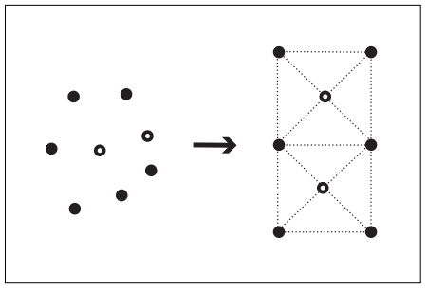
Case Based Complexity
Each case is being considered as a whole
All the attributes are involved in the consideration of similarity
Each case is treated as a complex system
The parts (attributes) are not separated from the whole (case) as variables that operate separately
Potential for similarity with other cases is an emergent property of each case

Slide 24
Qualitative and quantitative attributes
Some qualitative attributes do support similarity assessment
Human and Chimpanzee are more similar than Human and Tree, and
Human and Tree are more similar than Human and Sun
But that relies on an implicit distance measure from a taxonomy of life
Nominal variables are defined as being non-comparable and unordered
Eye colour
Nationality
Mode of transport
Will take that up with QCA later, and instead cluster over only quantitative attributes

Slide 25
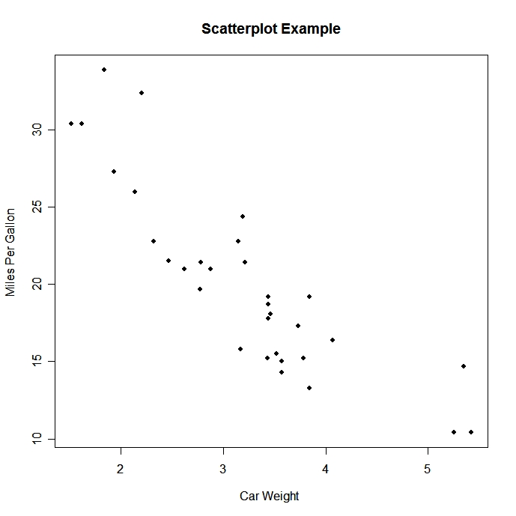
Conceptualising a case in multidimensional space
If there are only two attributes
Position on 2D coordinate system describes the whole case
Example - R built-in dataset: cars
Each car has two attributes, car weight (in 1000 lbs) and fuel economy (in miles per US gallon)
Datsun 710 attribute values are 2.320 weight and 22.8 fuel economy

Slide 26
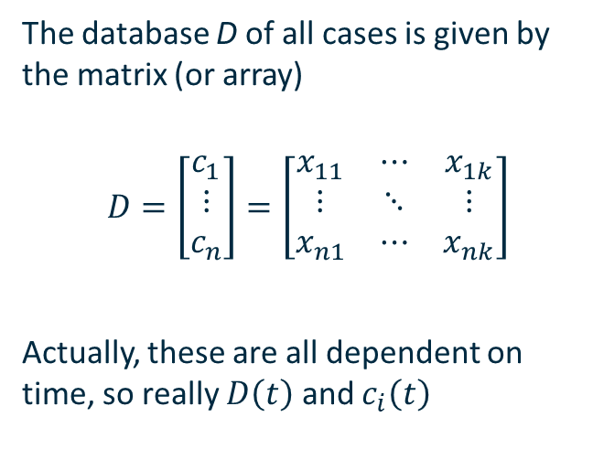
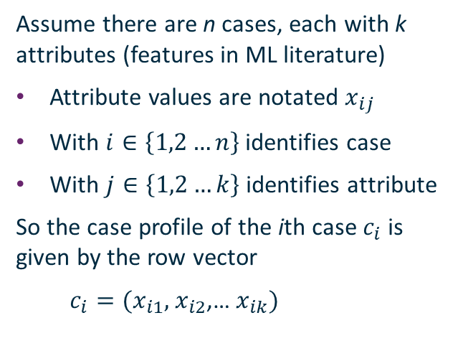
Mathematical formulation
Assume there are n cases, each with k attributes (features in ML literature)
Attribute values are notated $x_{ij}$
With $i∈\left\{1,2…n\right\}$ identifies case
With $j∈\left\{1,2…k\right\}$ identifies attribute
So the case profile of the ith case $c_{i}$ is given by the row vector
$c_{i}=(x_{i1},$ $x_{i2}$,… $x_{ik})$
The database D of all cases is given by the matrix (or array)
$$D=\left[\begin{matrix}c_{1} \\ ⋮ \\ c_{n}\end{matrix}\right]=\left[\begin{matrix}x_{11} & ⋯ & x_{1k} \\ ⋮ & ⋱ & ⋮ \\ x_{n1} & ⋯ & x_{nk}\end{matrix}\right]$$
Actually, these are all dependent on time, so really $D\left(t\right)$ and $c_{i}\left(t\right)$

Slide 27
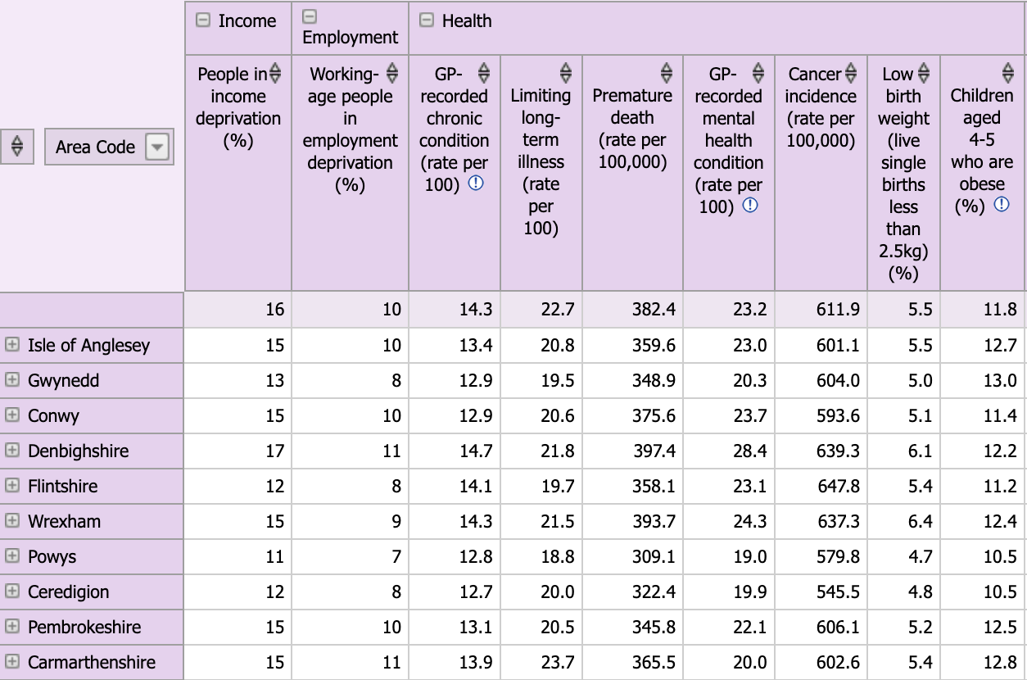
Case conceptualisation includes values of all attributes
Different from variable orientation
Considering all attributes simultaneously
Case →
← Case Profile
https://statswales.gov.wales/Catalogue/Community-Safety-and-Social-Inclusion/Welsh-Index-of-Multiple-Deprivation/WIMD-Indicator-data-2019/indicatordata-by-localauthority

Slide 28
Similarity in 2-dimensional space
Consider two cases as if they only had two attributes
Datsun 710: attribute values are 2.320 weight and 22.8 fuel economy
Mazda RX4: attribute values are 2.620 weight and 21.0 fuel economy
What does similarity mean?
These two cars are near each other
Indicates similar attribute values
Distance is a measure of similarity

Slide 29
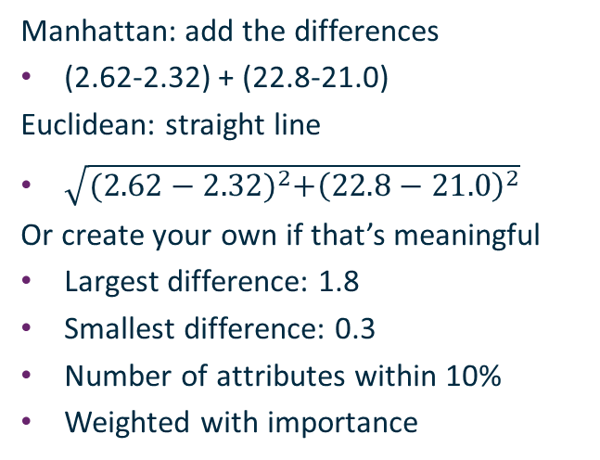
Distance measures in 2-dimensional space
Manhattan: add the differences
(2.62-2.32) + (22.8-21.0)
Euclidean: straight line
$\sqrt{{{(2.62−2.32)}^{2}+\left(22.8−21.0\right)}^{2}}$
Or create your own if that’s meaningful
Largest difference: 1.8
Smallest difference: 0.3
Number of attributes within 10%
Weighted with importance
Datsun 710: 2.320 and 22.8
Mazda RX4: 2.620 and 21.0

Slide 30
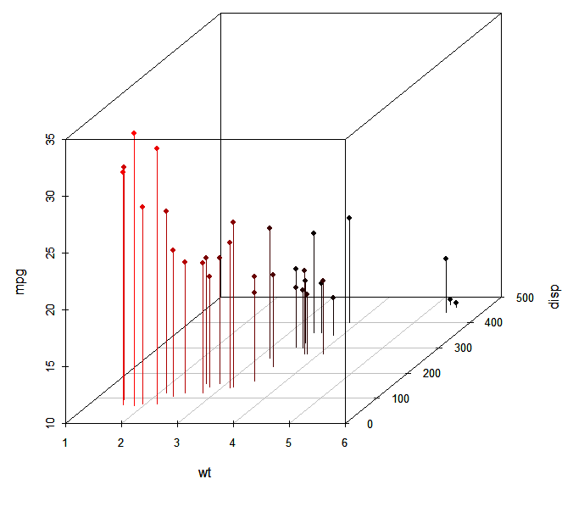
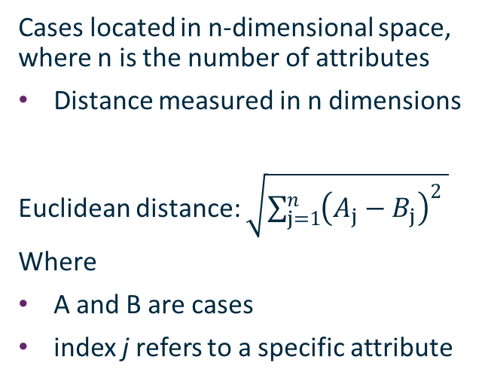
Additional attributes require extension to distance metric
Cases located in n-dimensional space, where n is the number of attributes
Distance measured in n dimensions
Euclidean distance: $\sqrt{\sum_{j=1}^{n}{{\left(A_{j}−B_{j}\right)}^{2}} }$
Where
A and B are cases
index j refers to a specific attribute
Same set of cars, but now have three attributes, also engine size (displacement)

Slide 31
Conceptualising a case in multidimensional space: key ideas
Case is conceptually located in multidimensional space
One dimension for each (quantitative) attribute
Coordinate is determined by the value of the relevant attribute
Similarity of cases is equivalent to “close to” in the multidimensional space
Similarity of cases is with respect to a specific way of measuring distance
Euclidean distance is common distance metric for quantitative attributes

Slide 32
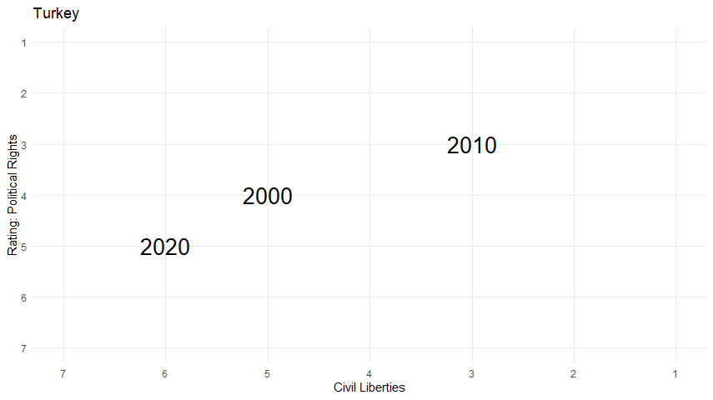
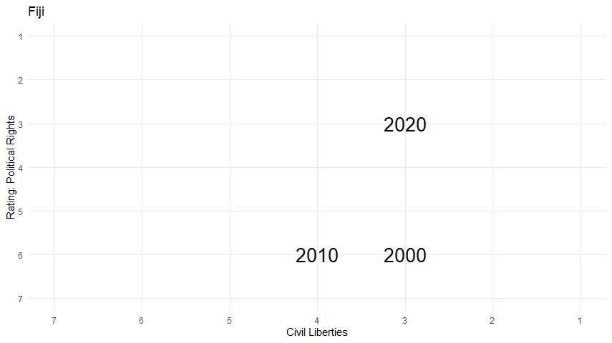
Cases are dynamic (attribute values change over time)
As attribute values change, the case ‘moves’ in multidimensional space
Trajectories can be similar
Start points near each other and end points near each other
Similar directions and distance moved
Cases that are similar at one time point may be dissimilar at another time point
Trajectories are different
Complex systems are path dependent
Freedom in the World index, Freedom House
https://freedomhouse.org/reports/publication-archives

Slide 33
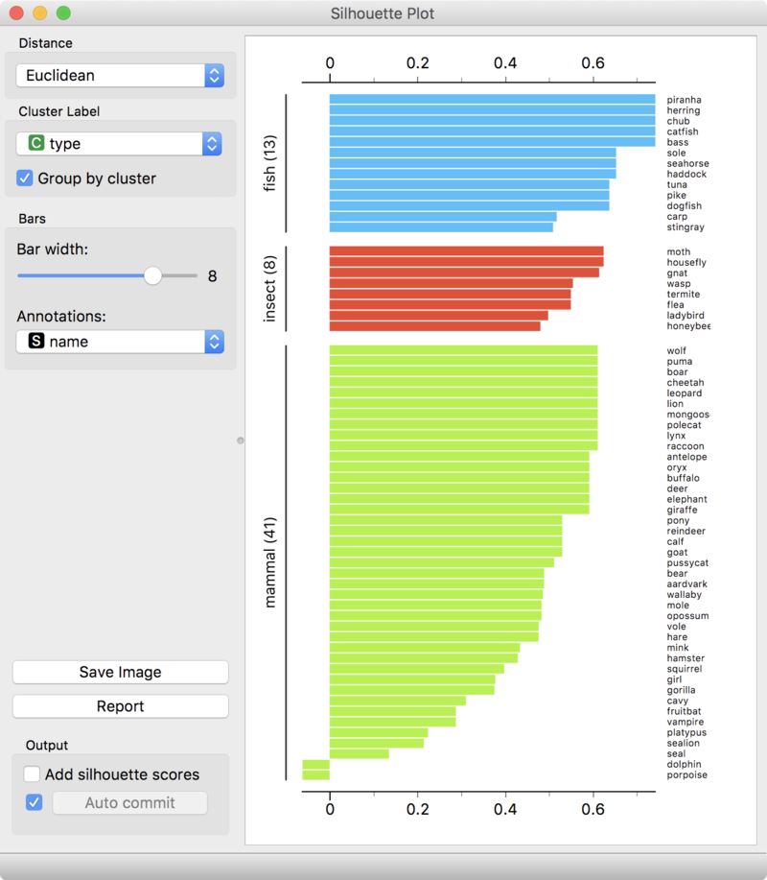
Clustering Algorithms and Examples

Slide 34
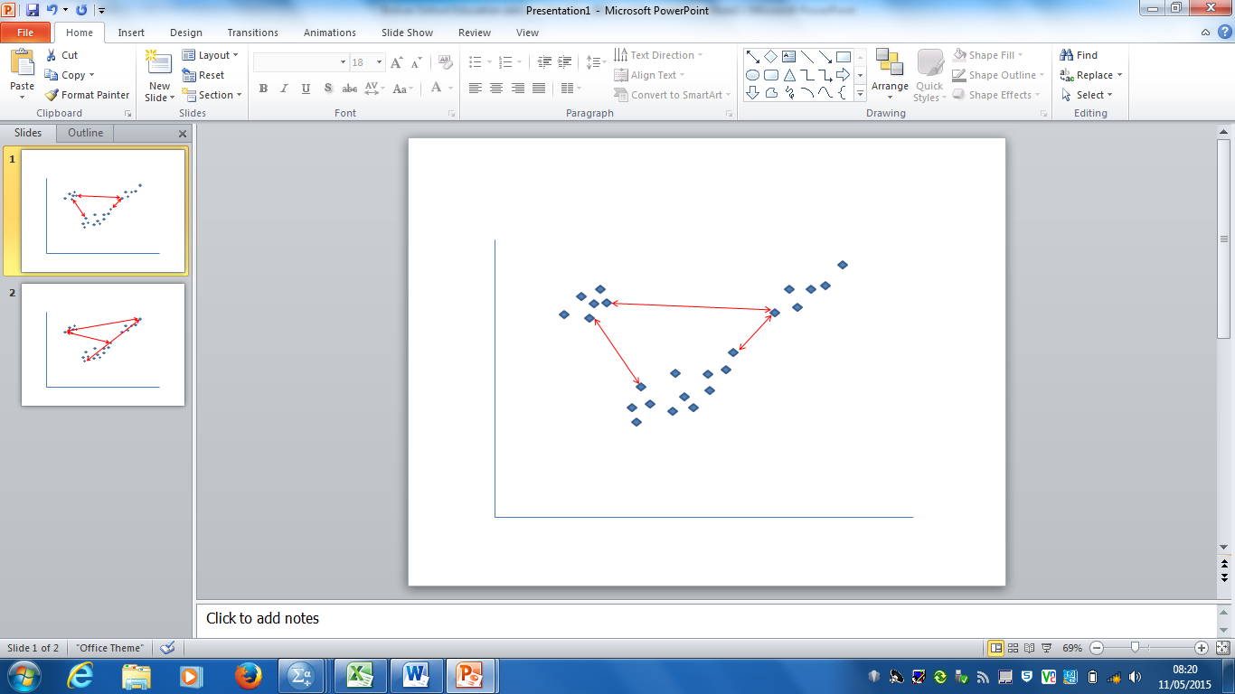
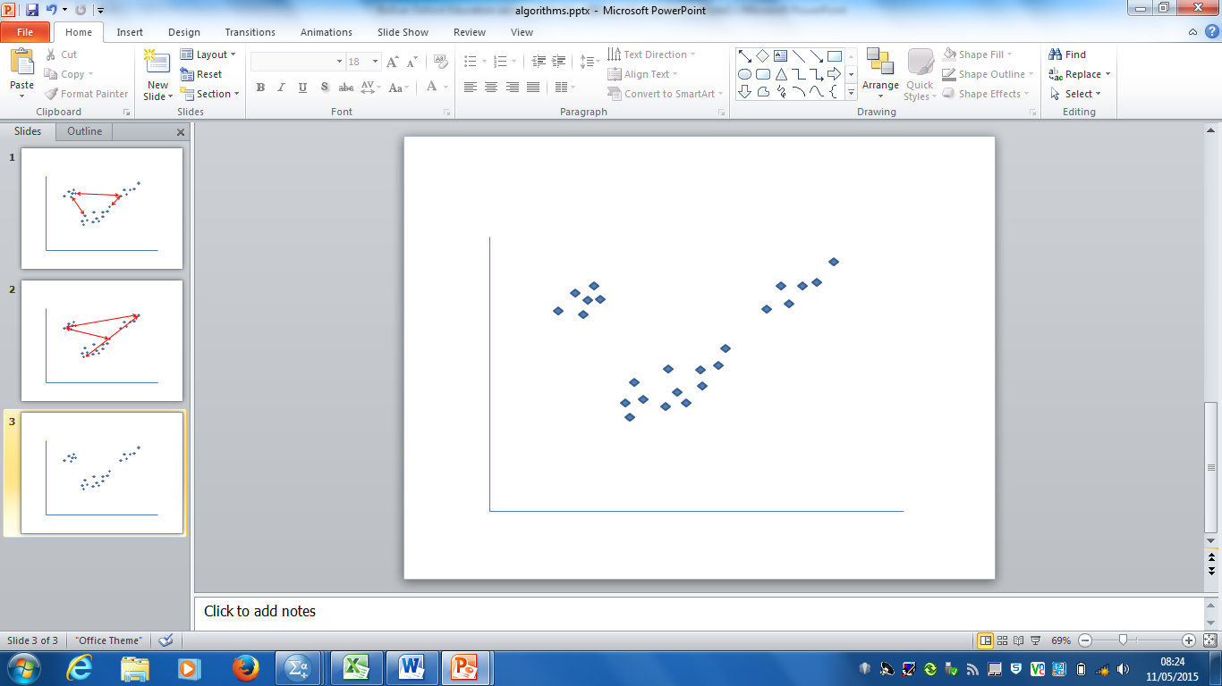
Objective of clustering
Goal is to allocate cases to clusters
Cases within a cluster are close to each other (similar)
Clusters are far from each other (different)
Both use same distance metric
Many cases in each cluster so can measure difference between clusters in different ways
Nearest neighbour
Between-groups average

Slide 35
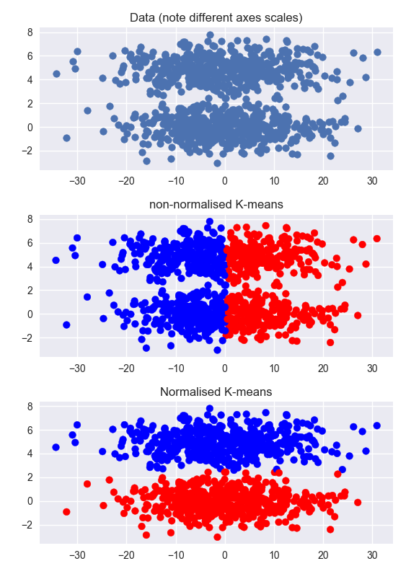
Preparing data for clustering
Remove cases with missing values
Case is the meaningful unit
Case is all of the attribute values
Consider whether attribute values should be scaled to a common range
Distance metrics are affected by scales
If all attribute values are in same range (such as [0:1], or to mean 0 and SD 1) then they have similar weight in the distance calculation
StackOverflow user Nought101
https://stats.stackexchange.com/questions/89809/is-it-important-to-scale-data-before-clustering

Slide 36
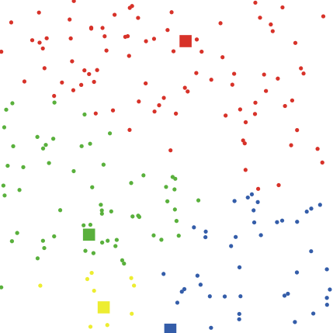
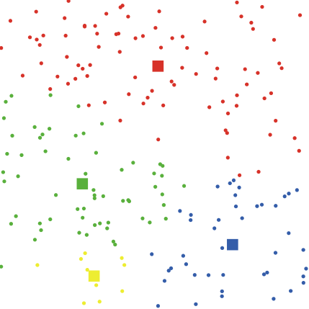
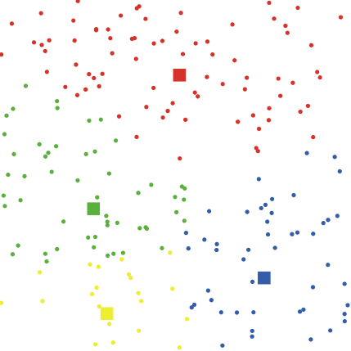
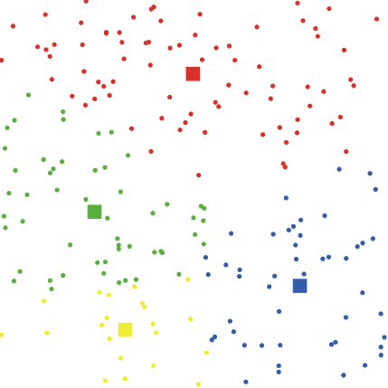
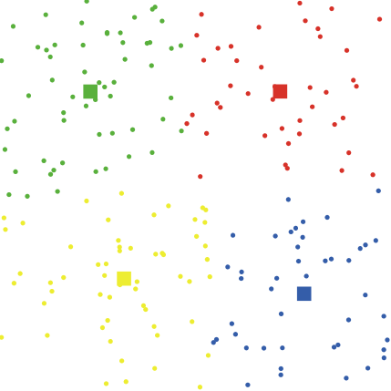
Clustering with k-means
Goal is to group cases for closeness within group and farness between groups
Choose number of clusters (k)
Randomly select k cases and set centroids in those locations
Assign each case to closest centroid
Calculate new centroid position as mean of positions of cases in the cluster
Iterate until centroids stable
Note: random start so try multiple choices
Can use ensemble

Slide 37
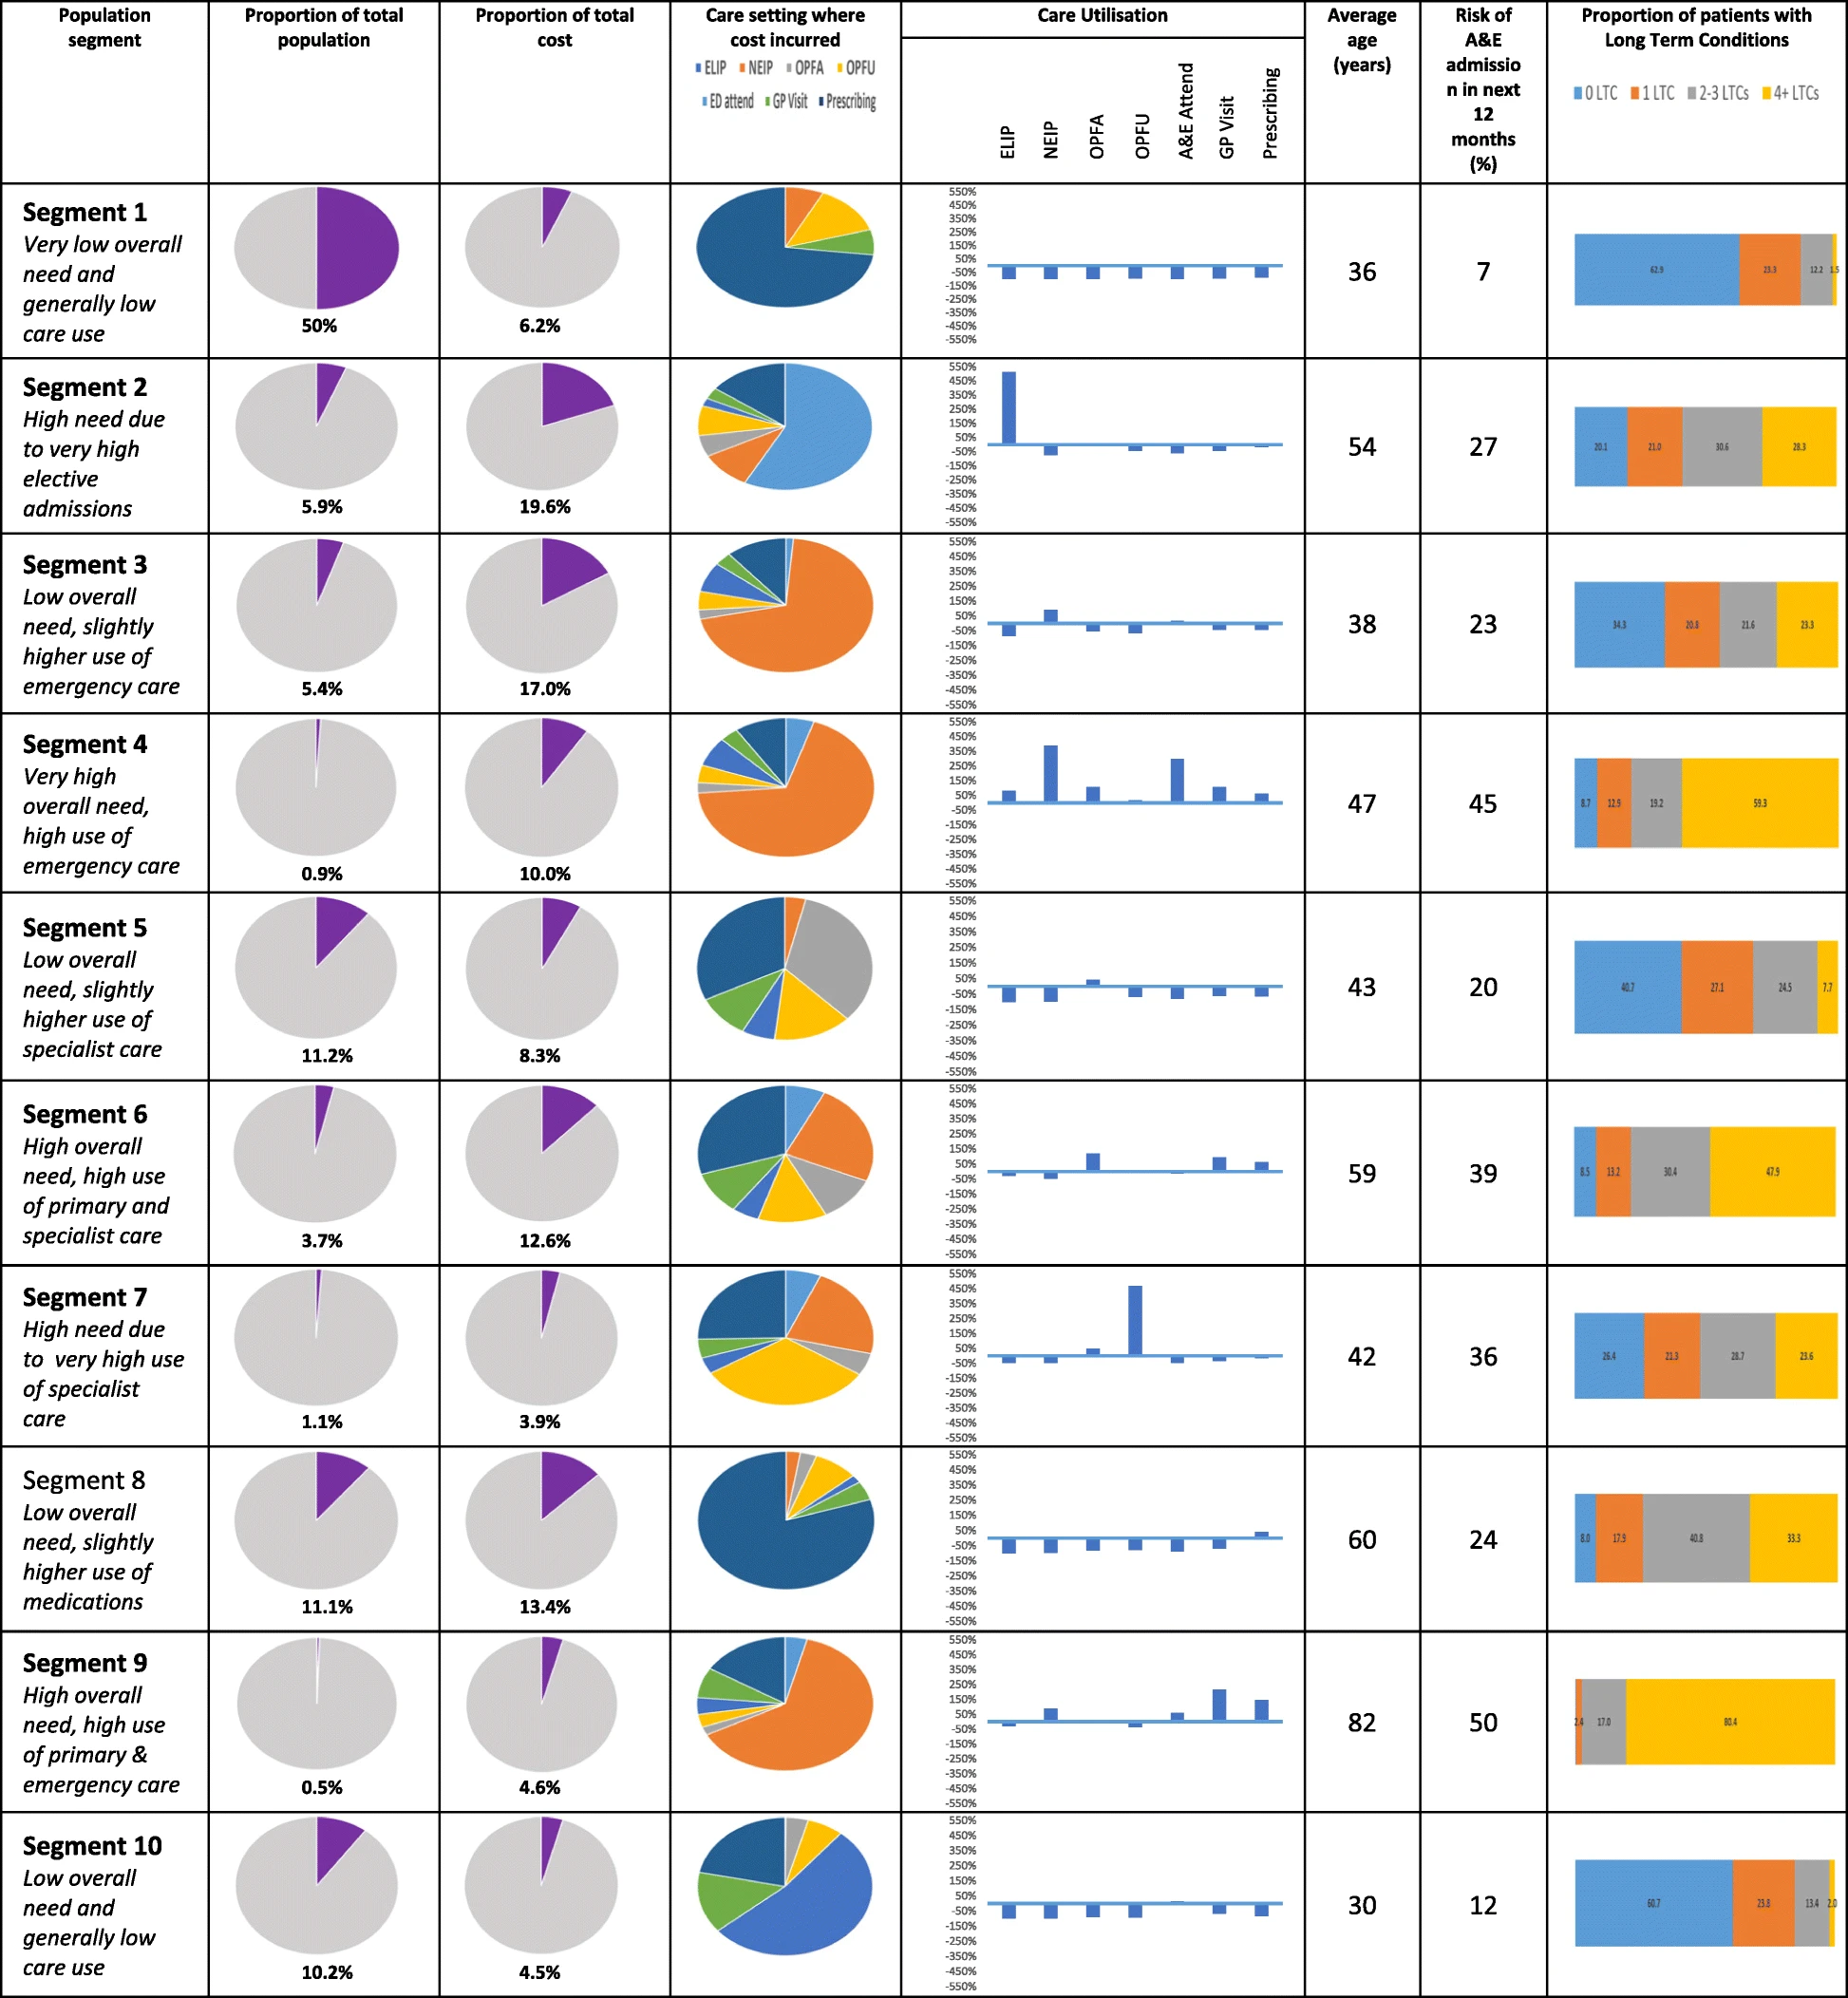
k-means, population segmentation on health service use
Linked database of primary and secondary care
79,607 patients with 7 variables about healthcare utilisation
Found 10 clusters with homogenous needs
Potential for tailored programmes
Prevention (low need) or active monitoring (high need)
Nnoaham et al (2020). Can cluster analyses of linked healthcare data identify unique population segments in a general practice-registered population? Fig 1
https://www-nature-com.ezphost.dur.ac.uk/articles/s41591-018-0107-6

Slide 38
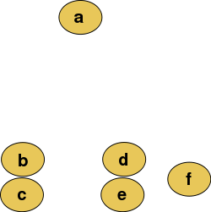
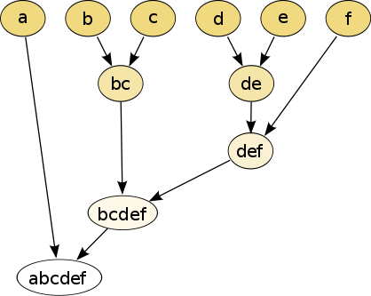
Hierarchical clustering: Agglomerative
Cases (two attributes)
Bottom up (agglomerative) approach
Initialise with each case assigned to its own cluster
Iteratively, until all in a single cluster
Find the pair of clusters that are closest together
Combine that pair
Cut the dendrogram at height that gives good outcome
Cutting at blue line would give three clusters: {a} and {b,c} and {d,e,f}
Dendrogram
Figure from: https://en.wikipedia.org/wiki/Hierarchical_clustering

Slide 39
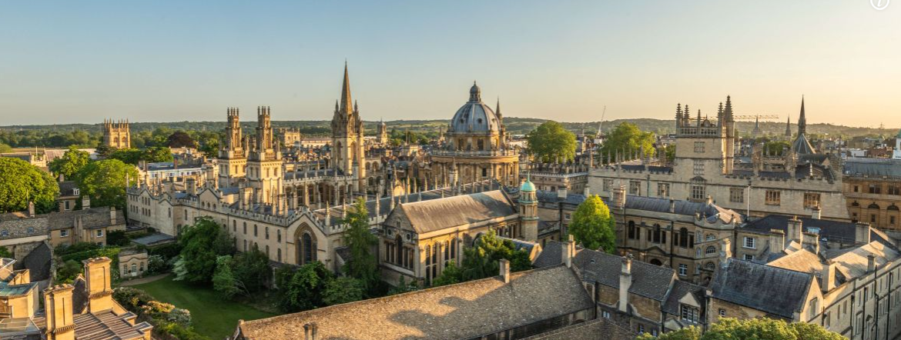
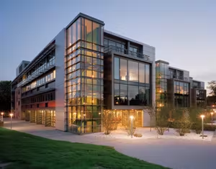
Hierarchical clustering, UK universities
Questions
Are there Distinctive Clusters of Higher and Lower Status Universities in the UK?
If there are clusters, what differentiates them?
Research activity
Adjusted research income
% postgraduates
REF 2008
Teaching environment
% Satisfaction with teaching
% satisfied with feedback
‘Value-added’ score
Economic resources
Investment income
% spend on academic services
Student-staff ratio
Academic selectivity
Average UCAS points on entry
% degree completion
% ‘good degree’
Social mix
% Undergraduates not from low participation neighbourhoods
% from NS-SEC 1-3
% from private schools

Slide 40
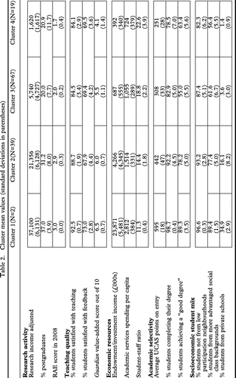
Hierarchical clustering, UK universities
Oxbridge
Most other Old
Mainly New
Struggling New
Found 4 clusters with different attribute profiles
Oxford and Cambridge separate cluster
Other Russell Group not distinct from other old universities
Boliver (2015): Are there Distinctive Clusters of Higher and Lower Status Universities in the UK? doi: 10.1080/03054985.2015.1082905

Slide 41
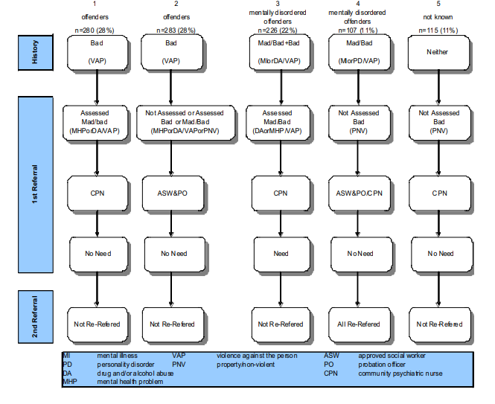
Hierarchical clustering paths, mental health and offending
Three time points about same 1011 offenders referred to NE custody diversion team over 2.5 years
Criminal and psychiatric history
First referral to CDT
Second referral (if exists) to CDT
Hierarchical clustering used in two ways
Clusters for each time point
Clusters for trajectories through the 3 time points
Found 5 pathways, key is whether assessed
Dyer (2006). “The Psychiatric and Criminal Careers of Mentally Disordered Offenders Referred to a Custody Diversion Team in the United Kingdom, International Journal of Forensic Mental Health, 5:1, 15-27, doi: 10.1080/14999013.2006.10471227

Slide 42
Organising clusters
Clusters exist in multi-dimensional space
Many attributes so many dimensions
Difficult to visualise and hence interpret
Visualisations focus on attribute values in each cluster
More difficult as number of attributes increases
Dimension reduction orders the clusters so that comparisons can focus on ‘nearby’ clusters

Slide 43
Dimension reduction distorts distances and position For example, moving from 2D to 1D
Rotate 90⁰ anticlockwise
Rotate 45⁰ clockwise
A
A
B
B
B
A
C
B
C
C
C
A
A
A
C
B
B
C
C
A
B
Same as viewing from left of slide in first image
Aside: PCA angle to maximise variation, hence separation

Slide 44
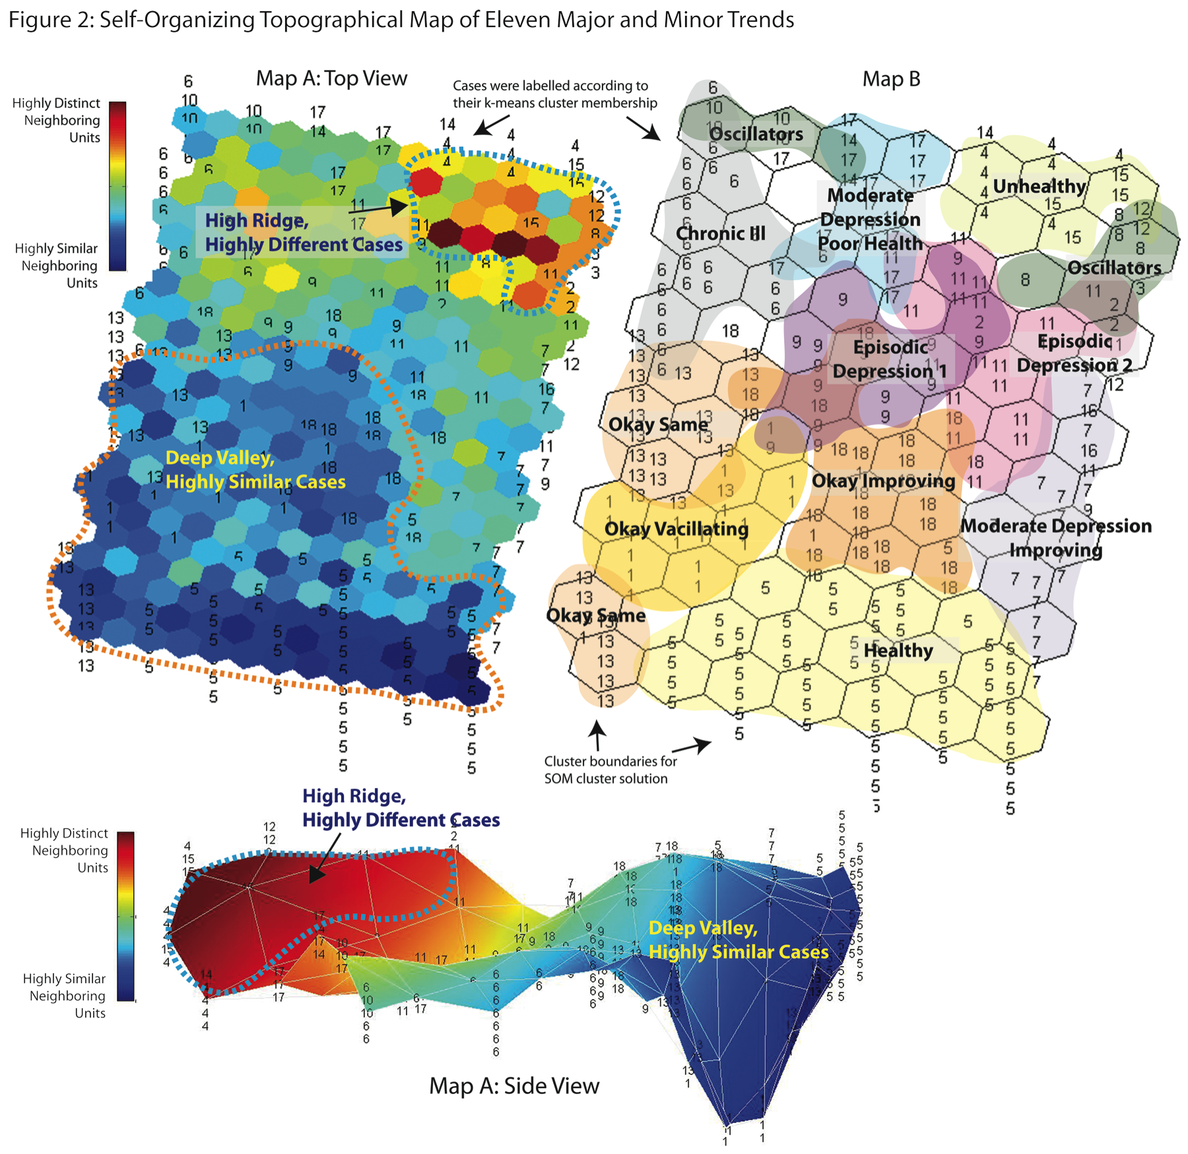
Self organising maps
Self organising maps (SOM)
Is a clustering method
Assigns cases to clusters
Is a dimension reduction method
Clusters that are close in higher dimensional attribute-space are close in the lower dimensional space
Used for visualisation as well as clustering
Reduce to 2D for ease of visualisation
Also referred to as Kohonen maps

Slide 45
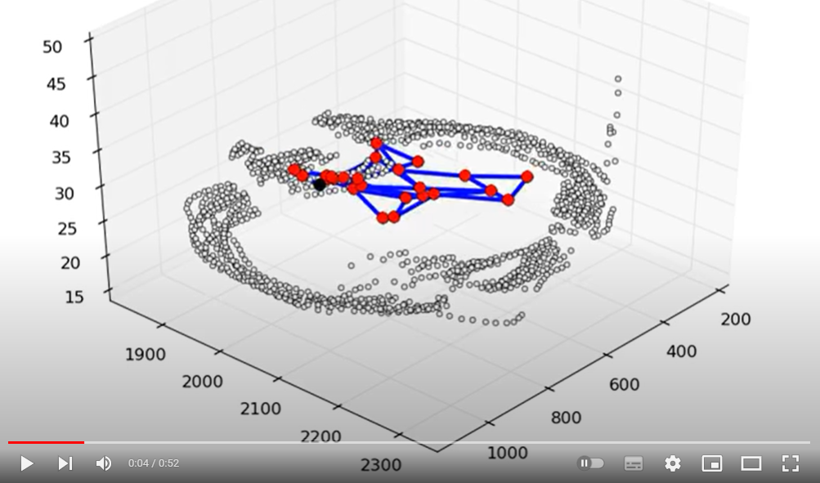
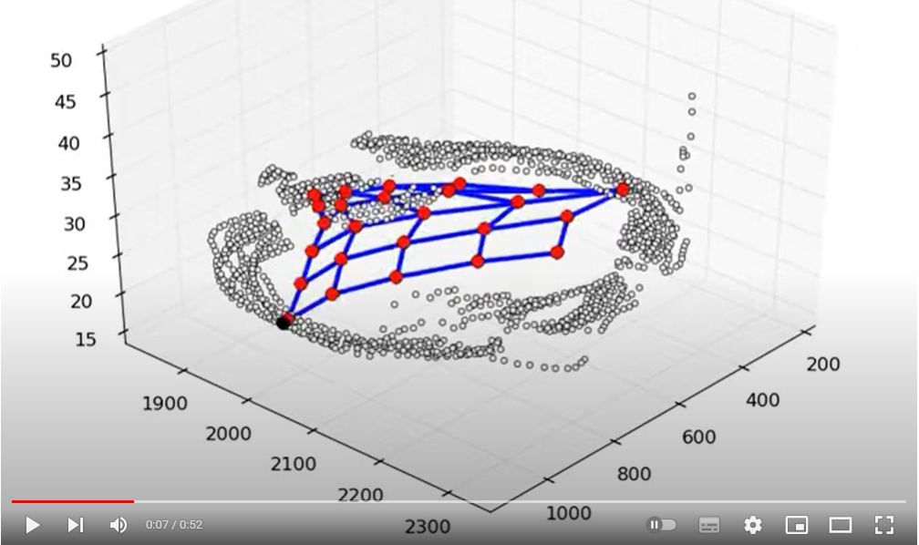
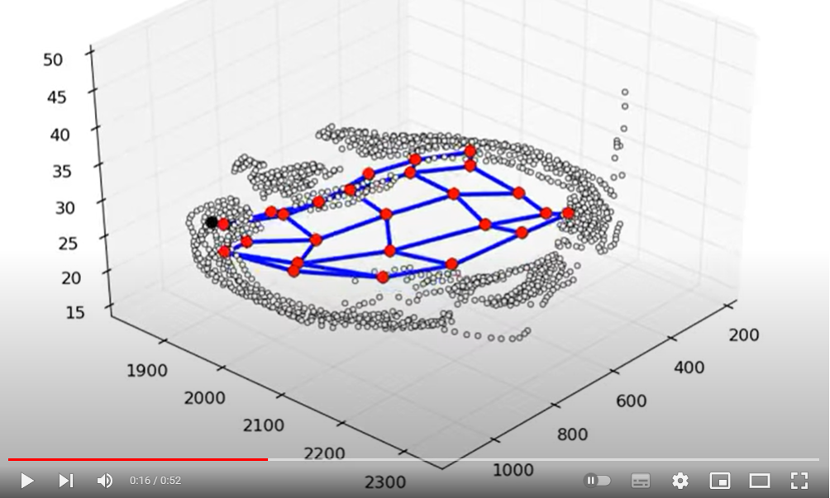
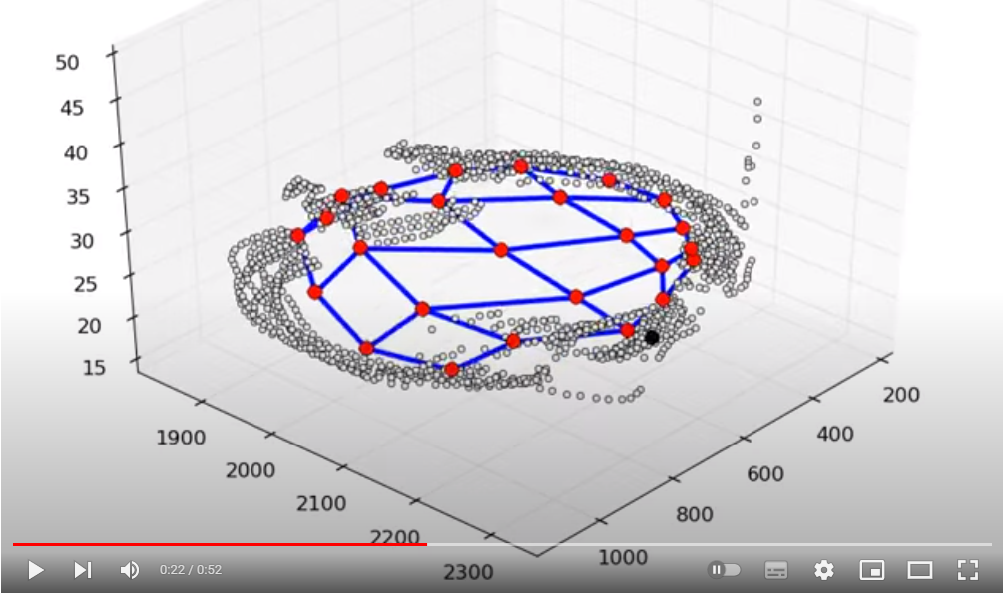
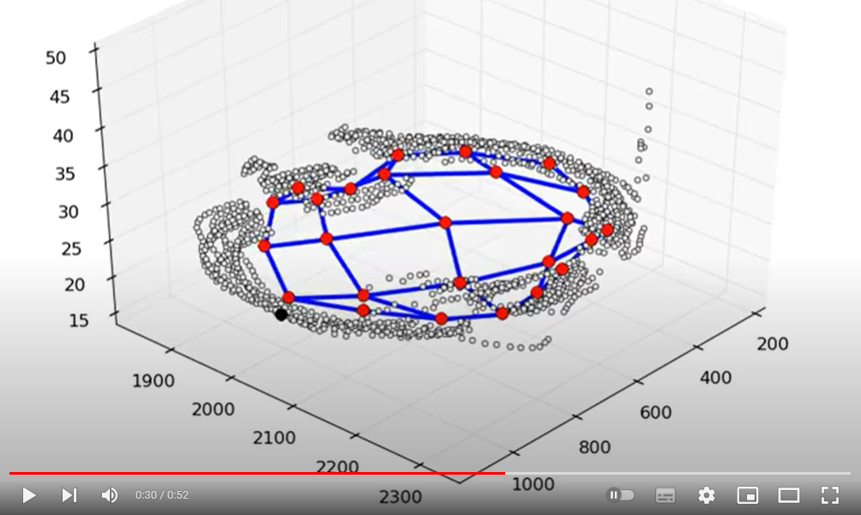
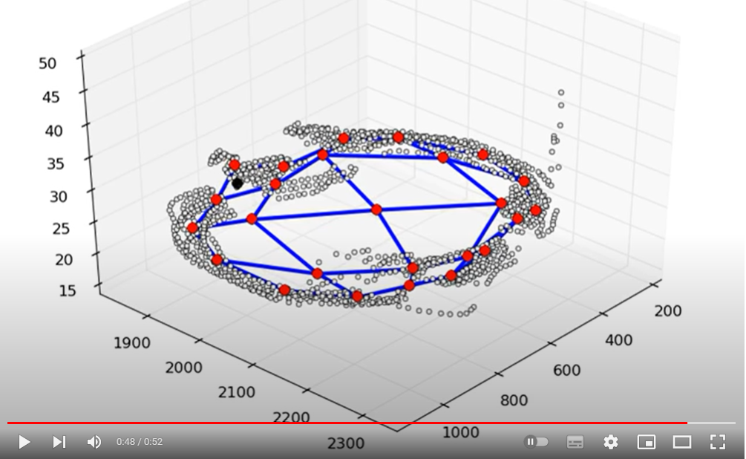
SOM algorithm
Initialise
Mesh of prototype clusters (neurons, synapses)
Each neuron assigned random values for all attributes (weights)
Iterate through all cases, random order
Find closest neuron
Update attribute values to move it toward case
Move neighbouring neurons toward case
Neurons eventually located in areas with high case density but also connected to each other
Cases in cluster of close neuron
bitLectures, Self-organizing map (grid topology)
https://www.youtube.com/watch?v=k7DK5fnJH94

Slide 46
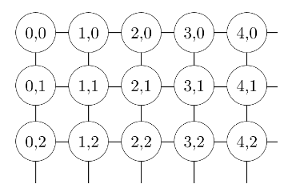

SOM hyperparameters
Mesh of neurons
Topology: rectangular or hexagonal
Size: need more neurons than expected clusters
Learning rate
How much the best matching unit (closest neuron) moves
Decreases over time so map converges
Neighbourhood
Radius: what neurons are also moved
Rate function: how much they move

Slide 47

SOM visualisation
U-matrix (unified distance): distance between neurons (clusters), dark=far
Clusters formed from voting patterns
Single attribute values (vote)
https://en.wikipedia.org/wiki/Self-organizing_map#/media/File:Synapse_Self-Organizing_Map.png

Slide 48

SOM depression and physical health trajectories
259 longitudinal cases
20 biomarkers for stress
23 health outcomes
11 time points
Found 11 trajectories
Used k-means to identify 18 clusters
Constructed 7x12 SOM
SOM to verify the k-means solution
Castellani et al (2018). Exploring comorbid depression and physical health trajectories: A case-based computational modelling approach. doi:10.1111/jep.13042

Slide 49

How many clusters?
Each additional cluster increase the amount of variation between attribute values ‘explained’ by the clustering
Fewer cases in each cluster, so more similar
Plot number of clusters against explained variation
Judgement as to the point at which additional clusters offer little improvement
Referred to as elbow
Justifies choice of number of clusters
Heuristic only: no correct method

Slide 50
Silhouette plots
Silhouette plots display the similarity of the cases within each cluster to help verify the clustering solution, whether clusters are meaningful
Silhouette value is a function of the case attributes and the assigned cluster
Let S = average distance to cases in same cluster
Let N = average distance to closest neighbour cluster
Silhouette value given by
1 - S / N for S < N (hence +1 for perfect fit with own cluster)
1 – N / S for N > S (hence -1 for perfect fit with neighbour)
Plot shows
Cluster assigned for each case
Silhouette value for each case
https://en.wikipedia.org/wiki/File:Silhouette-plot-orange.png

Slide 51
Clusters found depend on the attributes and method used
All of these are important
Specific attributes and how are they measured
Composition of the sample (what cases selected)
Clustering algorithm (hierarchical agglomerative, etc.)
Choices in the algorithm (hyperparameters such as number of clusters)
Distance metric
How distance between clusters is measured (eg nearest neighbour, average)
So how do we know if the groups we have found are real or meaningful and not just statistical artefacts?

Slide 52

Is the solution robust? Try different clustering methods and implementation details
Try with different hyperparameters such as number of clusters, initialisation, distance metric, and how to measure cluster distance
Remove some of the attributes: same results suggests robust
Introduce perturbations: slightly vary some attribute values or add fake cases with random attribute values, different results suggests not robust
Boliver (2015): Are there Distinctive Clusters of Higher and Lower Status Universities in the UK? doi: 10.1080/03054985.2015.1082905

Slide 53
Are the clusters meaningful and distinct? Are average attribute values different?
Oxbridge
Most other Old
Mainly New
Struggling New
Boliver (2015): Are there Distinctive Clusters of Higher and Lower Status Universities in the UK? doi: 10.1080/03054985.2015.1082905

Slide 54




Are the clusters consistent with other evidence?
Validity might also be ascertained through triangulation and/or mixed-methods research
Do the results align with those of other research?
If so, this lends credence to their validity
Can you verify the results using other methods?

Slide 55

Case-Based Complexity
(wrap up)

Slide 56
In what ways is clustering a case based complexity method?
Case is a complex system
Cases are treated as a composite of their attributes
Attributes are interdependent, reflecting the history of the case
Cases are dynamic, attribute values change over time
Case is the unit of analysis in clustering methods
All attributes are used to assess similarity and difference
Outcome of the analysis is a catalogue of case profiles (at a particular point in time)
Method is about identifying patterns in the cases
Similar profiles clustered together
Clusters help to understand diversity of cases

Slide 57

Diversity of cases
Statistical methods and case based complexity differ in their attitude to diversity
In statistics, average is meaningful for a variable
Good at interchangeable (fungible) cases
In case based methods, all clusters are important
There is no average cluster
Small clusters show meaningful differences
A set of cases is more diverse where
More clusters are required to cover the cases
Cases are distributed evenly between clusters

Slide 58
Review: How does clustering work?
Clustering is an exploratory method in the big data toolbox
Cases are conceptually located in multidimensional space
Each dimension refers to one attribute
Goal is to allocated cases to clusters so that
Cases within a cluster are close to each other
Clusters are distant from each other
Euclidean (straight line) is common distance metric

Slide 59

Challenges
Essential to treat clustering as an exploratory method
Finding clusters does not mean the cases are structured
Any dataset can be clustered, even random noise
Always investigate the meaning of the clusters
How robust are the clusters?
Are the differences between attribute values meaningful?
Are the clusters far apart?

Slide 60

Next session: Case Based Complexity Workshop
Dataset
USArrests – built in R dataset
Cases are US States
Attributes are criminal offence rates
Cluster and visualise
k-means
Hierarchical clustering
Self organising map
R packages (+ tidyverse)
cluster
factoextra, dendextend
kohonen, SOMbrero

Slide 61


Alternative software: COMPLEX-IT
COMPLEX-IT
https://www.art-sciencefactory.com/complexit.html

Slide 62




Alternative software: Orange
Orange
https://orangedatamining.com/

